Slide 1
Room Database
ViewModel
LiveData
(Architecture Components in Android)

Slide 2
Why Use Architecture Components ?
The purpose of Architecture Components is to provide guidance on app architecture, with libraries for common tasks like lifecycle management and data persistence.
Architecture components help you structure your app in a way that is robust, testable, and maintainable with less boilerplate code(Repetitive Code).
Architecture Components provide a simple, flexible, and practical approach that frees you from some common problems so you can focus on building great experiences easily.

Slide 3
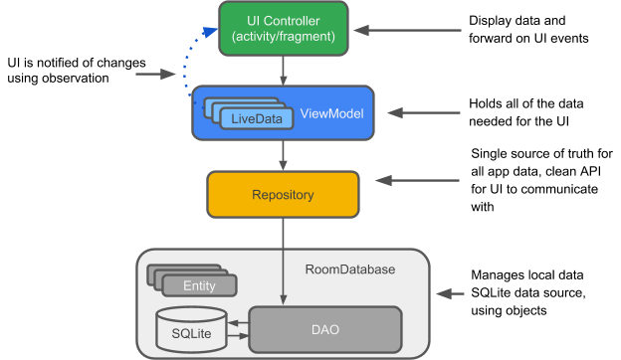
Introduction to the Architecture Components and how they work together?

Slide 4
Terminology:
Entity: This is an annotated class that describes a database table.
SQLite database: On the device, data is stored in an SQLite database.The Room persistence library creates and maintains this database for you.
DAO: Data access object. A mapping of SQL queries to functions. You used to have to define these painstakingly in your SQLiteOpenHelper class. When you use a DAO, you call the methods, and Room takes care of the rest.
Room database: Database layer on top of SQLite database that takes care of mundane tasks that you used to handle with an SQLiteOpenHelper. Database holder that serves as an access point to the underlying SQLite database. The Room database uses the DAO to issue queries to the SQLite database.

Slide 5
Terminology (Ctnd.)
Repository: You use the Repository for managing multiple data sources.
ViewModel: Provides data to the UI. Acts as a communication center between the Repository and the UI. Hides where the data originates from the UI. ViewModel instances survive configuration changes.
LiveData: A data holder class that can be observed. Always holds/caches latest version of data. Notifies its observers when the data has changed. LiveData is lifecycle aware. UI components just observe relevant data and don't stop or resume observation. LiveData automatically manages all of this since it's aware of the relevant lifecycle status changes while observing.

Slide 6
Implementation Procedure

Slide 7
Add Dependencies
open the build.gradle file for your project
add the google() repository as shown below
allprojects {
repositories {
jcenter()
google()
}
}

Slide 8
Add Dependencies (ctnd.)
Open the build.gradle file for your app or module
dependencies
{
implementation "android.arch.persistence.room:runtime:1.1.1"
annotationProcessor "android.arch.persistence.room:compiler:1.1.1”
implementation "android.arch.lifecycle:extensions:1.1.1"
}
For more information click here

Slide 9
2. Create the entity
@Entity(tableName = "your_table_name") Each @Entity class represents an entity in a table. Annotate your class declaration to indicate that it's an entity. Specify the name of the table if you want it to be different from the name of the class. @PrimaryKey Every entity needs a primary key.
@NonNull Denotes that a parameter, field, or method return value can never be null. @ColumnInfo(name = "your_coloumn_name") Specify the name of the column in the table if you want it to be different from the name of the member variable.

Slide 10
3. Create the DAO
Create a new Interface
Annotate the class with @Dao to identify it as a DAO class for Room.
Declare a method to insert values: void insert(Entity object);
Annotate the method with @Insert. You don't have to provide any SQL! (There are also @Delete and @Update annotations for deleting and updating a row.)
Declare a method to delete all the values: void deleteAll();.
There is no convenience annotation for deleting multiple entities, so annotate the method with the generic @Query.

Slide 11
Create the DAO (cntd.)
Provide the SQL query as a string parameter to @Query. Use @Query for read and complicated queries and provide SQL.
@Query("DELETE FROM your_table_name")
Create a method to get all the words: getAllValues();.
Have the method return a List of values.
List<EntityClass> getAllValues();
Annotate the method with the SQL query:
@Query("SELECT * from your_table_name")

Slide 12
4. The LiveData class
When data changes you usually want to take some action, such as displaying the updated data in the UI. This means you have to observe the data so that when it changes, you can react. Depending on how the data is stored, this can be tricky. Observing changes to data across multiple components of your app can create explicit, rigid dependency paths between the components. This makes testing and debugging difficult, among other things.
LiveData, a lifecycle library class for data observation, solves this problem. Use a return value of type LiveData in your method description, and Room generates all necessary code to update the LiveData when the database is updated.

Slide 13
5. Add a Room database

Slide 14
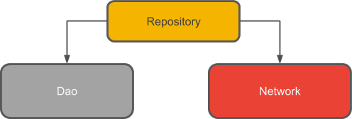
6. Create the Repository

Slide 15
Why use Repository ?
A Repository manages query threads and allows you to use multiple backends. In the most common example, the Repository implements the logic for deciding whether to fetch data from a network or use results cached in a local database.

Slide 16
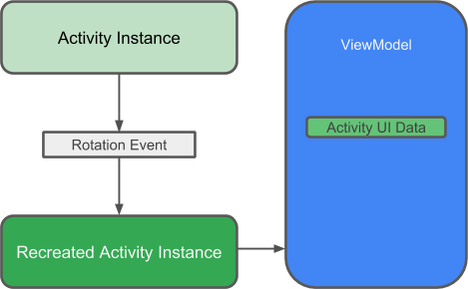
7. Create ViewModel

Slide 17
Why Use ViewModel ?
A ViewModel holds your app's UI data in a lifecycle-conscious way that survives configuration changes. Separating your app's UI data from your Activity and Fragment classes lets you better follow the single responsibility principle: Your activities and fragments are responsible for drawing data to the screen, while your ViewModel can take care of holding and processing all the data needed for the UI.
In the ViewModel, use LiveData for changeable data that the UI will use or display. Using LiveData has several benefits:
You can put an observer on the data (instead of polling for changes) and only update
the UI when the data actually changes.
The Repository and the UI are completely separated by the ViewModel. There are no database calls from the ViewModel, making the code more testable.

Slide 18


